Slide 1
3.4 Addendum: bias correction in SA algorithms
ESTP Training
05-07 October 2026

Slide 2
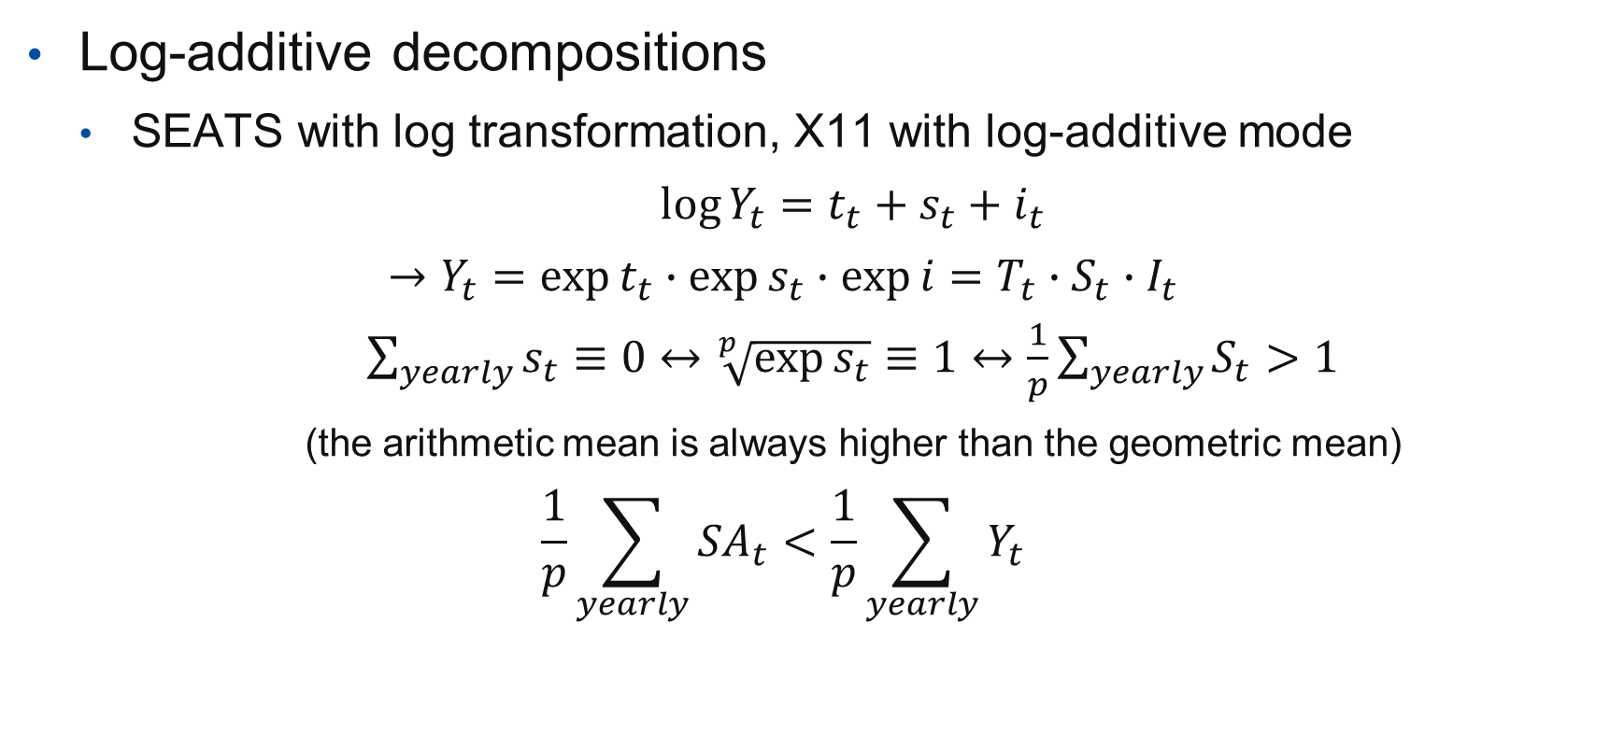
Description of the problem
Log-additive decompositions
  SEATS with log transformation, X11 with log-additive mode
  $\log{Y_{t}}=t_{t}+s_{t}+i_{t}$
  $$→Y_{t}=\exp{t_{t}}∙\exp{s_{t}}∙\exp{i}=T_{t}∙S_{t}∙I_{t}$$
  $\sum_{yearly}{s_{t}}≡0↔\sqrt[p]{\exp{s_{t}}}≡1↔\frac{1}{p}\sum_{yearly}{S_{t}}>1$
  (the arithmetic mean is always higher than the geometric mean)
  $$\frac{1}{p}\sum_{yearly}{{SA}_{t}}<\frac{1}{p}\sum_{yearly}{Y_{t}}$$

Slide 3
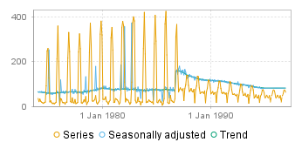
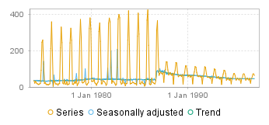
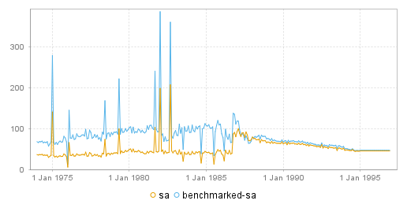
Possible solutions
Avoid log transformations (multiplicative X11)
Correct S, I and T for their average bias on the whole series (Tramo)
  But…
Don’t correct the bias
Experimental options (X12): smooth correction
Don’t correct and apply benchmarking

Slide 4
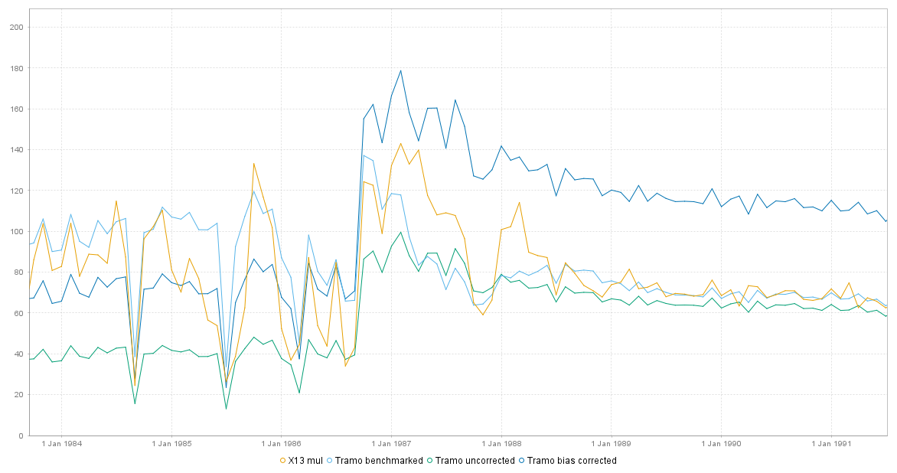

Slide 5
Additional remarks
Bias correction will generate some revisions (constant factor)
Currently no good solution in JD+ if the seasonal factors highly differ following the periods

